Slide 1
The Permissions Spectrum
Offensive Computer Security (FSU Spring 2014)

Slide 2
Hi my name is: root

Slide 3
Outline
Basics of a system (Linux)
BIOS, bootloader, OS
Rings Model
Permissions
VR
Linux

Slide 4
The BIOS
Is the ultimate authority of what hardware is and is not installed on a system.
(typically)
:)

Slide 5
Boot Process
BIOS
POST
CMOS
Hardware initialization (CPU, Video Card, …)
Bootloader
OS

Slide 6
Linux boot up
Boot loader (i.e. GRUB, LILO), then presents the boot options
calls start_kernel() on the selected option
start_kernel() performs most of the system setup
interrupt handling, memory manager, device initialization, drivers
start_kernel() spawns the idle process, process scheduler, and the init process (which is in userspace)

Slide 7
The Kernel
Handles all operating system processes
memory management,
task scheduling (context switching)
I/O (and CPU interrupts, per packet, keystroke, etc...)
interprocess communication
and overall system control
Kernel is typically loaded as an image file, compressed into either zImage or bzImage formats (using zlib).
Linux has a monolithic kernel

Slide 8
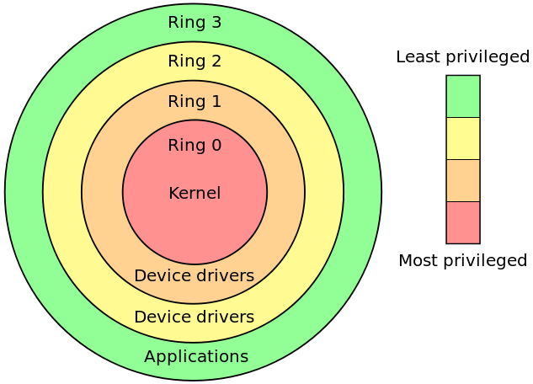
The “Academic” Rings model
For fault tolerance, and security
Provide different levels of access
3 Normal non-root user applications
2 Device drivers (keyboard / mice / …)
1 Device drivers (video card, etc)
0 Kernel

Slide 9
The Rings security Model
Things operate higher than ring 0
SMM (-2) (System Management Mode) on intel chips
IPMI (-3)
BIOS (-1)
The original Multics had 8 rings!
had special register for ring #

Slide 10
The “Practical” Rings model
For fault tolerance, and security
Provide different levels of access
4 Sandboxed non-root user applications
3 Normal non-root user applications
0 Kernel / root user
-1 BIOS
-2 SMM
-3 IPMI (Servers)
Physical Access

Slide 11
Vulnerability Research
Privilege Escalation:
Type of attack resulting in higher (or more) permissions for user/attacker.
Vulnerability Research:
Research on pulling off / preventing “priv-escs”
Goes beyond to -1, -2, -3

Slide 12
Vulnerability
Research
RING
3
RING
0
Defense in depth:
In theory attacking something with layered, additive defenses should be harder
Sometimes going from 3 to -3 is harder than 3 to 0
IPMI (Today’s reading)
RING
-1
RING
-2
RING
-3

Slide 13
Pivoting: Priv Esc to remote system
Target 1
Target 2

Slide 14
Pivoting: Lateral Movement
Target 1
Target 2
Target 3
Pass the Hash (PtH)

Slide 15
Target 1
Target 2
Target 3
Pass the Hash (PtH)

Slide 16
Linux Topics

Slide 17
Kernel space
Where most device drivers run (@ ring 1-2)
Note that modern micro-kernel trends are pushing drivers into userspace.
Much different from user space
A crash here can be fatal
random number generation is very difficult
mistakes are unforgiving

Slide 18
Kernel modification
Modifying the kernel requires recompiling it, and rebooting from the new kernel to use it
unless ksplice or kexec are used
Mistakes are fatal
Difficult to use this in attack chain

Slide 19
init process (user space, ring 3)
Init is the father of all processes
it establishes and operates the entire user space
takes a parameter: runlevel (from 1 to 6)
run level determines which subsystems are run
Executes:
scripts to set up all non-operating system services and structures for the user environment
checks and mounts the file system
spawns the gui (if configured to)
Then presents the user with the login screen

Slide 20
init process (user space), cont
init scripts are located usually in directories such as:
/etc/rc....../
The toplevel configuration file for init is at /etc/inittab
Init checks for the runlevel parameter in /etc/inittab as well.

Slide 21
init process (user space), cont..
init goes dormant after all of the specified processes have been spawned
waits for 3 things to happen:
a process init has started is ending / dying
a power failure signal
or a request to /sbin/telnit to change the run level
There are other init alternative binaries (depending on the system), such as systemd, or upstart

Slide 22
User space
More security layers here.
root is king
common to have a single user account per service (apache's httpd, mysqld)
can be set to no login
The least privilege principle...

Slide 23

File system, deleting files
Deleting files can work somewhat like this (on hard disk).
Data gets left on the disk, and the inode is just unlinked,
so sectors usually have old data from other files in them->
unless securely deleted

Slide 24
File system basics ( ext2/ext3.. ufs, ffs, and others derived from the original fast file system (ffs)
Directory Entry
File Name Inode
(memory)
Inode (index node)
contains permissions, ownership info, timestamps, and other metadata
Accessed Time Size ..... UID GID
(memory or disk)
Blk 1 Blk 2 ... Indirect Blk 1
there are fifteen 4K sized block pointers per inode usually
(disk)
File Content
File Content
File Content
Indirect block (contains addresses of more blocks)
File Content

Slide 25
File system basics ( ext2/ext3.. ufs, ffs, and others derived from the original fast file system (ffs)
Directory Entry
Other Directory Entry
File Name X Inode
File Name Y Inode
Inode (index node)
....Meta Data....
Accessed Time Size ..... UID GID
(memory or disk)
Blk 1 Blk 2 ... Indirect Blk 1
there are fifteen 4K sized block pointers per inode usually
(disk)
File Content
File Content
File Content
Indirect block (contains addresses of more blocks)
File Content

Slide 26
General delete behavior (can differ per file system!!!)
Directory Entry
The inode on disk will remain, and be marked for garbage collection. Memory inode will go away
File Name Inode
The inode gets "unlinked"
Inode (index node)
Accessed Time Size ..... UID GID
Blk 1 Blk 2 ... Indirect Blk 1
(memory or disk)
there are fifteen 4K sized block pointers per inode usually
(disk)
File Content
File Content
File Content
Indirect block (contains addresses of more blocks)
File Content
Data remains on disk, and is available for the file system's automated garbage collection (can happen at any time)

Slide 27
General delete behavior (can differ per file system!!!)
The inode gets "unlinked"
Directory Entry
Other Directory Entry
File Name X Inode
File Name Y Inode
Inode (index node)
....Meta Data....
Accessed Time Size ..... UID GID
(memory or disk)
Blk 1 Blk 2 ... Indirect Blk 1
there are fifteen 4K sized block pointers per inode usually
(disk)
File Content
File Content
File Content
Indirect block (contains addresses of more blocks)
File Content

Slide 28

Generic directory layout for linux distros
Can vary, and can be confusion per distro
Is not really standardized
Can be difficult at first to figure out where programs, icons, config files, and other stuff is
So lets go over the most interesting places:

Slide 29
Generic directory layout highlights
< / >
This is the root directory. This is where the Linux FS begins. Every other directory is under it. Do not confuse it with the root account, or the root account's home directory.
< /etc >
The config files for the Linux system. Most are text files and can be edited by hand

Slide 30
Generic directory layout highlights
< /bin > and < /usr/bin >
These directories contain most of the binaries (programs) for the system. The /bin directory contains the most important programs:
shells,
ls, grep
/usr/bin contains other applications for the users
No real clear distinction purpose-wise between the two.

Slide 31
Generic directory layout highlights
< /sbin > and < /usr/sbin >
Most system administration programs are here
< /usr >
Most user applications, their source code, pictures, docs, and other config files. /usr is the largest directory on a linux system.
< /lib>
The shared libraries (shared objects) for programs that are dynamically linked are stored here

Slide 32
Generic directory layout highlights
< /boot >
Boot info is stored here. The linux kernel is also kept here. The file vmlinuz is the kernel.
< /home >
Where all the users' home directories are. Every user has a directory under /home, and its usually where they store all their files.

Slide 33
Generic directory layout highlights
< /root >
The superuser's (root) home directory
< /var >
contains frequently changed variable data when the system is running. Also contains logs (/var/log), mail (/var/mail), and print info (/var/spool)
< /tmp >
scratch space for temporary files

Slide 34
Generic directory layout highlights
< /dev >
Contains all device info for the linux system.
Devices are treated like files in linux, and you can read/write to them just like files (for the most part).
< /mnt >
Used for mount points
HD's, USB's, CD-ROM's must be mounted to some directory in the FS tree before being used. Debian sometimes uses /cdrom instead of /mnt

Slide 35
Generic directory layout highlights
< /proc >
This is a special, and interesting directory.
/proc is actually a virtual directory, b/c it does not actually exist.
It contains info on:
the kernel
all processes info
Contains special files that permit access to the current configuration of the system.

Slide 36
Users and groups
File permissions are specified in terms of the permissions of
The file owner (self)
The file's group members (group / business)
and everyone else (other)
ls -l
chmod
-R recursive, ie include objects in subdirectories
-f force, forge ahead with all objects even if errors occur
-v verbose, show objects processed

Slide 37
Users and groups
chattr / lsattr
chown
chgrp

Slide 38
/etc/passwd and /etc/shadow
The /etc/passwd file contains users':
user id
password hash or info (usually not included in the etc/passwd file anymore...)
user identifier
group identifier *(also stored in /etc/group)
the user's home directory path
the program that launches when the user logs in (i.e. their shell)
entries look like:
jsmith:x:1001:1000:Joe Smith,Room 1007,(234)555-8910,(234)555-0044,email:/home/jsmith:/bin/sh

Slide 39
/etc/shadow
man 3 crypt (shows the encryption man page)
options are:
$1$: it uses MD5.
$5$: it uses SHA-256.
$6$: it uses SHA-512.
$2a$: it uses blowfish, not supported everywhere.
Otherwise it uses DES.
md5 no longer secure
default is DES based, with a 2 character salt string [a–zA–Z0–9./]
salt is used to perturb the hash, in one of 4096 ways

Slide 40
The least privilege principle
every process/user/program must be able to access only the information and resources that are necessary for its legitimate purpose
i.e. single no-login user accounts for services like httpd, msqld, etc...
jails
security in depth
Makes logs cleaner

Slide 41
chroot
The root directory (i.e. /) is stored within each process's entry in the process table. All the chroot() system call does is to change the location of the root directory for that process.
Is seen as an OS-level virtualization mechanism.
The result is called a "chroot jail"
can be easily broken. Nothing prevents a program from chrooting out of the jail typically...

Slide 42
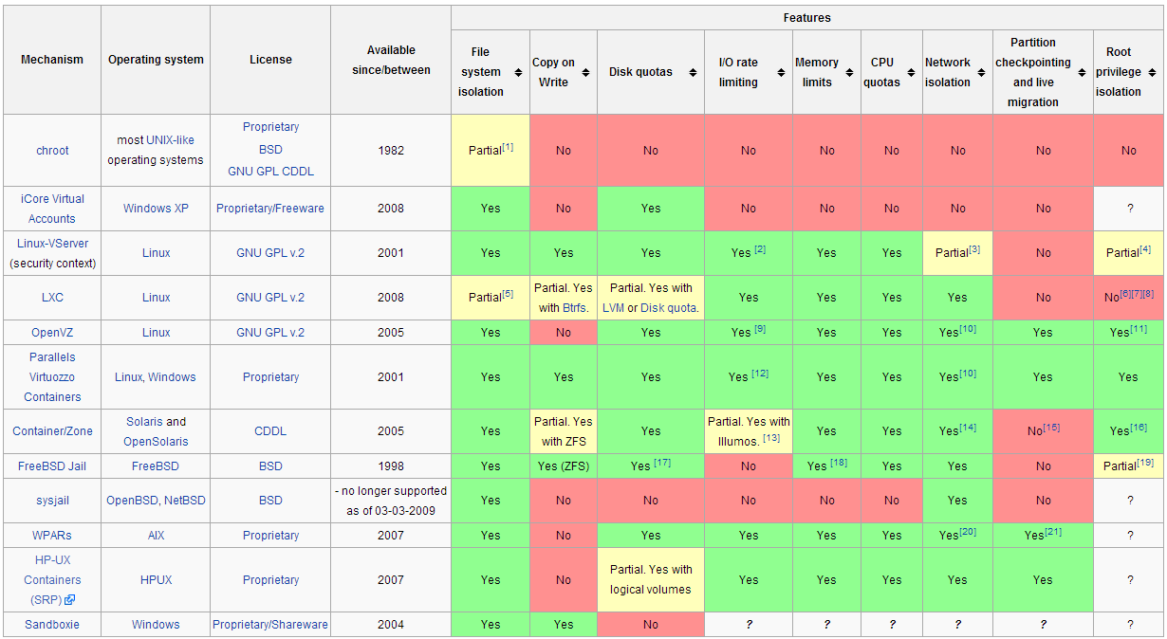
Existing OS level virtualizations
source: http://en.wikipedia.org/wiki/Jail_(computer_security)

Slide 43
File ownage and setuid setgid
Set User Id (upon execution) and Set Group ID (upon execution).
Are flags that allow a binary to be executed with the permissions of the binary's owner
Certain applications need to execute under other user account permissions
example: passwd
modified the /etc/passwd or /etc/shadow files which are owned by root.
Can't just let anyone edit this freely

Slide 44
Process Permissions: Euid vs Ruid
Effective User ID = UID number
Determines permissions of process
Real User ID = username
See http://www.cyberciti.biz/tips/linux-more-on-user-id-password-and-group-management.html

Slide 45
setuid (as root) programs
these programs have complete access on a UNIX system
virtually every attack chain involves a focus on attacking these programs
they are the single points of failure
once attackers get any form of access, they want to escalate to root
find / -perm -4000 -print
will find all setuid programs

Slide 46
Some example results (ubuntu12.04)
/usr/sbin/uuidd
/usr/sbin/pppd
/usr/lib/openssh/ssh-keysign
/usr/lib/eject/dmcrypt-get-device
/usr/lib/dbus-1.0/dbus-daemon-launch-helper
/usr/lib/policykit-1/polkit-agent-helper-1
/usr/lib/pt_chown
/usr/lib/chromium-browser/chromium-browser-sandbox
/usr/bin/lppasswd
/usr/bin/sudo
/usr/bin/passwd
/usr/bin/chfn
/usr/bin/X
/usr/bin/pkexec
/usr/bin/arping
/usr/bin/mtr
/usr/bin/gpasswd
/usr/bin/newgrp
/usr/bin/at
/usr/bin/chsh
/usr/bin/traceroute6.iputils
/usr/bin/sudoedit
/sbin/mount.ecryptfs_private
/bin/su
/bin/ping6
/bin/fusermount
/bin/mount
/bin/ping
/bin/umount
This can all be seen as the attack surface for any suid permission escalation attacks
good source: http://www.acm.uiuc.edu/workshops/security/setuid.html

Slide 47
Priv Esc Attack Surface
suid priv escs
kernel priv escs
daemon exploits / root process exploits
weak passwords
…

Slide 48
setuid and setgid on directories
entirely different
setuid in a directory:
does nothing! Is disabled on almost all unix systems
setgid on a directory:
new files and new subdirectories within inherit the directory's gid
instead of the creator's primary gid
enables shared workspaces for groups

Slide 49
Access Control Lists
Usually are disabled by default
Extendeds the owner/group/other access model to allow much finer control
can specify permissions for each individual user and group defined in the system
is a mount option that can be turned on for specific permissions in the /etc/fstab file
example entry in /etc/fstab:
UID=dfb1151a-be85-496f-8c3c-32804b947446 / ext4 errors=remount-ro,acl 0 1

Slide 50
Access Control Lists
On debian can then install ACL utilities
$ apt-get install acl
or use eiciel (a GUI based ACL manager)
Example use: Say we have a file "target.txt" that we want the following to be able to edit:
joe (the CEO)
developers-g (the developer's group)
qa-g (the quality assurance & testing group)

Slide 51
ACL Example
developers-g is the group owner for Target.txt
To enable ACL:
$ setfacl -m group:developers-g:rw- Target.txt
TO enable R/W perm for qa-g, and joe:
$setfacl -m group:qa-g:--x,user:joe:rw- Target.txt

Slide 52
ACL Example
Pretty simple!!
Note: ls- l will not display the ACL of a file, only if an ACL is enabled by a + sign at the end of permissions. Example:
-rw-rw-r--+ 1 bob bob 60097 2013-01-01 10:55 Target.txt

Slide 53
Extended file attributes (xattr)
supported by ext2, ext3, ext4, JFS, ReiserFS, XFS, Btrfs...
attr / lsattr / chattr interesting uses:
chattr +i = immutable (means no one, not even root can change/delete/link the file)
chattr +a = make file append-only (great for logs security!)
chattr +s = secure deletion for file
By default only root can use xattr, but can be enabled for all in /etc/fstab with the user_xattr option

Slide 54
tty
A TTY is a native terminal device (the backend is either kernel or hardware emulated)
named after TeleTYpewriter (TTY)
TTY ports are direct connections to the computer
i.e. keyboard, mouse, or serial connection
commands:
who - lists all users and their terminals
chvt - switch to another terminal (requires root)
no GUI (i.e. not the X environment)

Slide 55
pts
Pseudo Terminal Slave
Is a terminal emulated by another program
xterm, screen, ssh, expect, GNOME terminal, Mac OSX terminal....
is created through
Can switch terminals:
screen windowlist

Slide 56
Daemons
view them via "service" command
background processes
syslogd (system logging process)
sshd (ssh daemon for incoming ssh connections)
almost all daemons are spawned by init
standard behavior:
have no tty (controlling terminal)
ignore all terminal signals except SIGTERM
have no open file descriptors (no I/O)
dissassociated from process group

Slide 57
Kernel Modules
a Loadable Kernel Module (LKM) is an object file that contains code that extends the running kernel.
typically used to add support for new hardware, file systems, or adding system calls...
Convenient method for modifying the kernel
can be abused by attackers though...

Slide 58
cronjobs
cron is the time-based job schedule in Unix systems.
cron enables users to schedule jobs (commands or shell scripts) to run periodically or at certain times or dates
Commonly used to automate system maintenance or administration

Slide 59
Command history
can view previous commands:
history
can repeat previous commands:
!!
!ssh
can print the command instead of repeating it:
!ssh:p

Slide 60
logs
stored typically in /var/log/
messages - General log messages
auth.log, faillog, lastlog -authentication logs
boot.log - System boot log
syslog ( a log file and a C command)
daemon.log - running services such as ntpd, httpd, and etc logs
kern.log - kernel log file
mysql.log, mysql.err - database logs (different if postgres, mongo, or other DB)

Slide 61
logs continued
user.log (user level/application logs)
There are also virtual machine logs too
/var/log/apache2/ for apache2 logs
/var/log/snort/ for snort logs
and more....
There is a gui based log viewer for GNOME: gnome-system-log

Slide 62
logs are important also for attackers
brute force (i.e. ssh) attempts leave a big footprint
remote logins (ips/domains are logged)
system modification
kernel modification
module loading / unloading
daemon logs

Slide 63
logs are important also for attackers
Firewall / Gateway / Traffic logs
IDS
IPS
AD / LDAP / SCP / … logs
...

Slide 64
Linux Firewalls (host based)
Modern Linux host-based firewalls rely on a kernel-based system called "netfilter"
the iptables user-space tool allows for managing netfilter
Netfilter:
is a framework within the linux kernel
has 3 standard tables: filter, nat, mangle
is primarily a connection-tracking system
does NOT filter traffic itself, it provides functions for other tools to do that

Slide 65
Netfilter framework tables
Filter - default and most basic
INPUT, OUTPUT, FORWARD chains
responsible for system protection
NAT
Network Address Translation
MASQUERADE usage allows for routing multiple private IP addr's through a single public IP addr.
Mangle
For changing certain packet fields prior to local delivery.

Slide 66
iptables
part of almost all linux distros since 2.4 kernel (2001)
tables, chains, matches, and targets
policies are built from an ordered set of rules
each rule is applied to a chain within a table
an iptables chain is a collection of rules that are compared, in order, against packets that share common characteristics (inbound packets vs outbound for instance.

Slide 67
iptables
Tables:
this is a construct that delineates a broad category of functionality
packet filtering, NAT, etc.
4 tables:
1) filter (for filtering rules)
2) nat (for nat rules)
3) mangle (for specialized rules)
4) raw (for rules that function independent of the Netfilter connection tracking subsystem)

Slide 68
iptables
Chains:
Each table has own set of default chains
The most important built-in chains for us are the INPUT, OUTPUT, and FORWARD chains in the filter table
The INPUT chain used for packets destined for the local Linux system after routing calculations are done in kernel (i.e. addressed to local socket)
The OUTPUT chain is used for packets leaving the system
FORWARD chain governs packets routed through the system

Slide 69
iptables
Important chains in the NAT table:
PREROUTING
POSTROUTING
These are used to modify packet headers before and after IP routing calculations are made in kernel
Local Socket
User Space
Kernel Space
filter INPUT
filter OUTPUT
incoming packets
Routing Decision
filter FORWARD
outboundpackets
nat PREROUTING
nat POSTROUTING
figure source: Linux Firewalls, by Michael Rash

Slide 70
iptables
rule Matches:
Each rule has a set of matches, along with a target
Target tells iptables what to do with a packet that matches the rule

Slide 71
iptables
match examples
--source (-s) Match on source IP or network
--destination (-d) Match on dest IP or network
--protocol (-p) match on an IP value
--in-interface (-i) match on input interface (eth0)
--out-interface (-o) match on output interface (eth0)
--state match on a set of connection states
--string match on a sequence of application layer data bytes (not ASCII string...)
--comment a way to tag packets with a comment in the kernel

Slide 72
iptables
Targets:
when a packet matches a rule, the target (action) is triggered:
ACCEPT
DROP
LOG (logs a packet to syslog)
REJECT
RETURN (continues processing a packet within the calling chain)

Slide 73
iptables Policy Requirements
should be able to initiate the following through to firewall, to outside servers:
Domain Name System (DNS) queries
File Transfer Protocol (FTP) transfers
Network Time Protocol (NTP) queries
Secure SHell (SSH) queries
Simple Mail Transfer Protocol (SMTP) sessions
Web Sessions over HTTP/HTTPS
WHOIS queries

Slide 74
iptables Policy Requirements
Sessions initiated from the internal network should be statefully tracked by iptables
packets that do not conform to a valid state should be logged, and dropped
firewall should be configured with a default log and drop policy, to guard against any stray packets, port scans or unallowed connection attempts
perhaps block all incoming SSH traffic if applicable
We'll cover this more later... but the lesson here is: Firewalls are effective security defenses

Slide 75
ports and services
The /etc/services file contains network port names and numbers which can be used to determine firewall rules

Slide 76
What can go wrong if an attacker gets root
Everything

Slide 77
Questions?
redwood@cs.fsu.edu

